Slide 1
Module 2: Advanced IT Security
Cristina STOLOJESCU-CRISAN

Slide 2
4. Asymmetric Encryption Algorithms

Slide 3
Asymmetric encryption
public key cryptography
uses two keys to encrypt a plain text:
a public key
a private key
anyone with a secret key can decrypt the message
a message that is encrypted using a public key can only be decrypted using a private key
mostly used in day-to-day communication channels

Slide 4
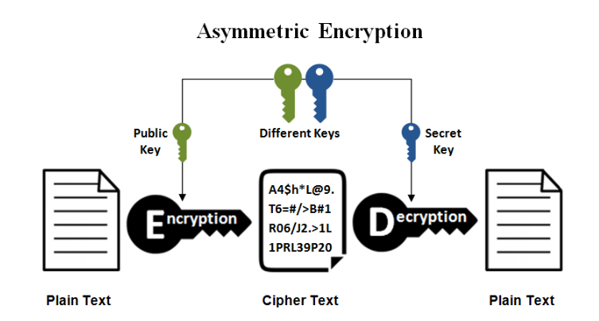

Slide 5
Asymmetric encryption algorithms
Diffie-Hellman (DH) key exchange
El-Gamal
Rivest-Shamir-Adleman (RSA)
Elliptic curve cryptography (ECC)

Slide 6
Diffie-Hellman key exchange

Slide 7
Diffie-Hellman (DH) key exchange
method of digital encryption - securely exchanges cryptographic keys between two parties over a public channel
1976: Whitfield Diffie and Martin Hellman
one of the first practical examples of public key cryptography
raises numbers to a selected power to produce decryption keys
the components of the keys are never directly transmitted
does not share information during the key exchange
TLS, SSH, IPsec

Slide 8
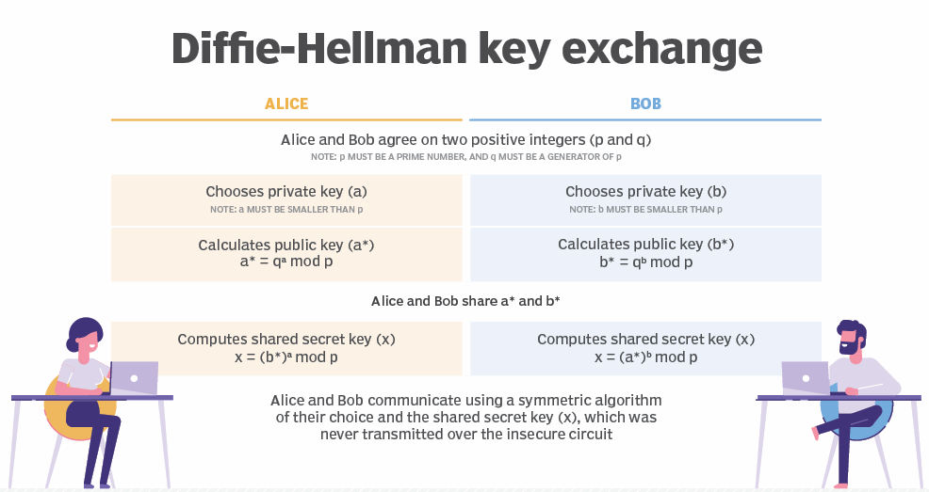
Image source: www.techtarget.com

Slide 9
Rivest-Shamir-Adleman (RSA)

Slide 10
Rivest-Shamir-Adleman (RSA)
the basis of a cryptosystem which enables public key encryption
widely used to secure sensitive data
1977 - Ron Rivest, Adi Shamir and Leonard Adleman of the MIT
two different but mathematically linked keys - one public and one private
the most widely used asymmetric algorithm -> confidentiality, integrity, authenticity, and non-repudiation

Slide 11
Applications of RSA
protocols: Secure Shell (SSH), OpenPGP, S/MIME, and SSL/TLS,
software programs - browsers
RSA signature verification

Slide 12
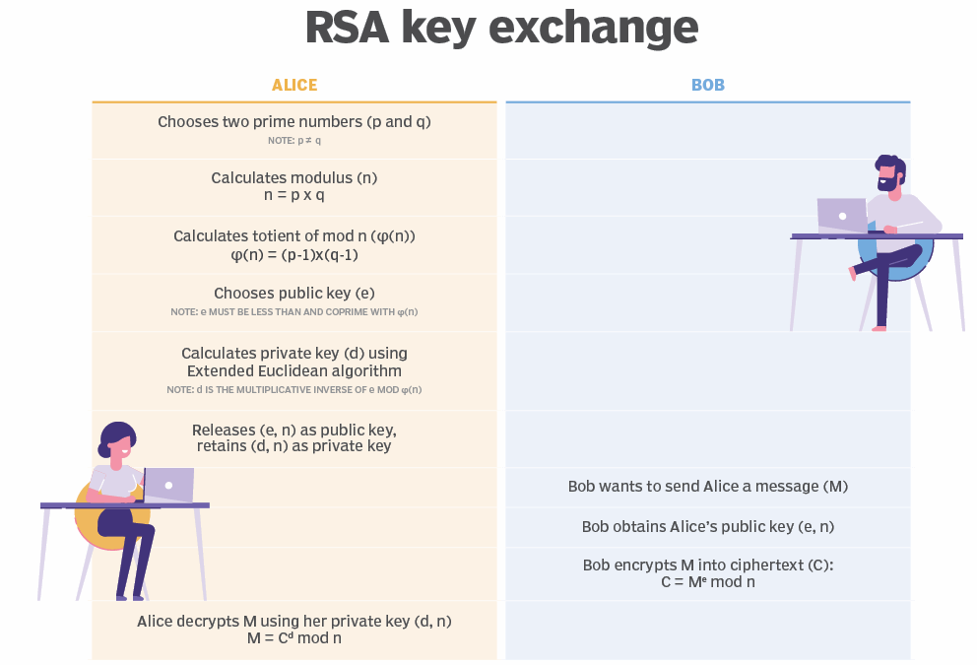
Image source: www.techtarget.com

Slide 13
El Gamal algorithm

Slide 14
ElGamal algorithm
public-key cryptosystem
1984 - Taher ElGamal
based on the discrete logarithm problem
based on the Diffie–Hellman key exchange
has not been patented - less expensive alternative

Slide 15
Advantages of ElGamal
Security
Key distribution
Digital signatures

Slide 16
Disadvantages of ElGamal
Slow processing
Key size
Vulnerability to certain attacks

Slide 17
Elliptic curve cryptography (ECC)

Slide 18
Elliptic curve cryptography (ECC)
public key encryption technique based on elliptic curve theory
used to create faster, smaller and more efficient cryptographic keys
alternative to the RSA algorithm
digital signatures in cryptocurrencies (Bitcoin and Ethereum)
one-way encryption of emails, data and software.
generates keys through the properties of an elliptic curve equation
level of security that requires fewer computing resources

Slide 19
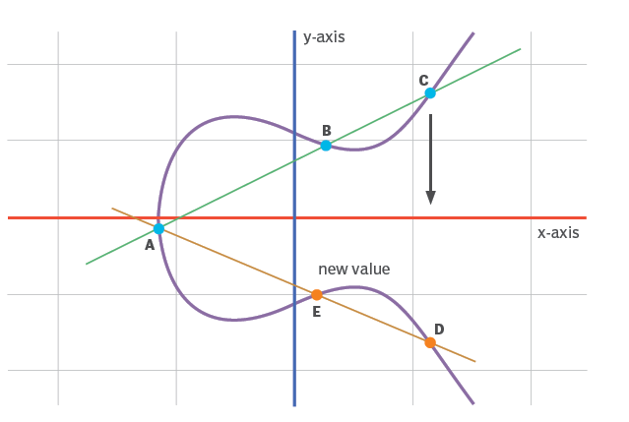
Image source: www.techtarget.com

Slide 20
Pros and cons of asymmetric encryption
Pros:
keys are never distributed or exchanged
private keys aren't transmitted/revealed -> increased security
digital signatures -> sender authentication
enables non-repudiation
Cons:
slower than symmetric encryption
loss of key - no decryption
public key ownership isn't authenticated
if a private key is stolen, an attacker could use it to decrypt their messages

Slide 21
Symmetric vs. asymmetric: Which is better?
consider the type of data being encrypted!
performance - asymmetric encryption - generally slower, more secure
symmetric and asymmetric encryption algorithms - different vulnerabilities
boost security
the landscape of cryptography is constantly changing

Slide 22
Homework
What is the most secure asymmetric encryption?
Can asymmetric encryption be broken?
What problem does asymmetric encryption solve that symmetric encryption does not?
Does Bitcoin use asymmetric encryption?

